Slide 1

Graph Coloring as a CSP – A Python-based Tool for Visualization
Understanding CSP and Its Application in Graph Coloring
Presented by :Ai Insight Explorer

Slide 2
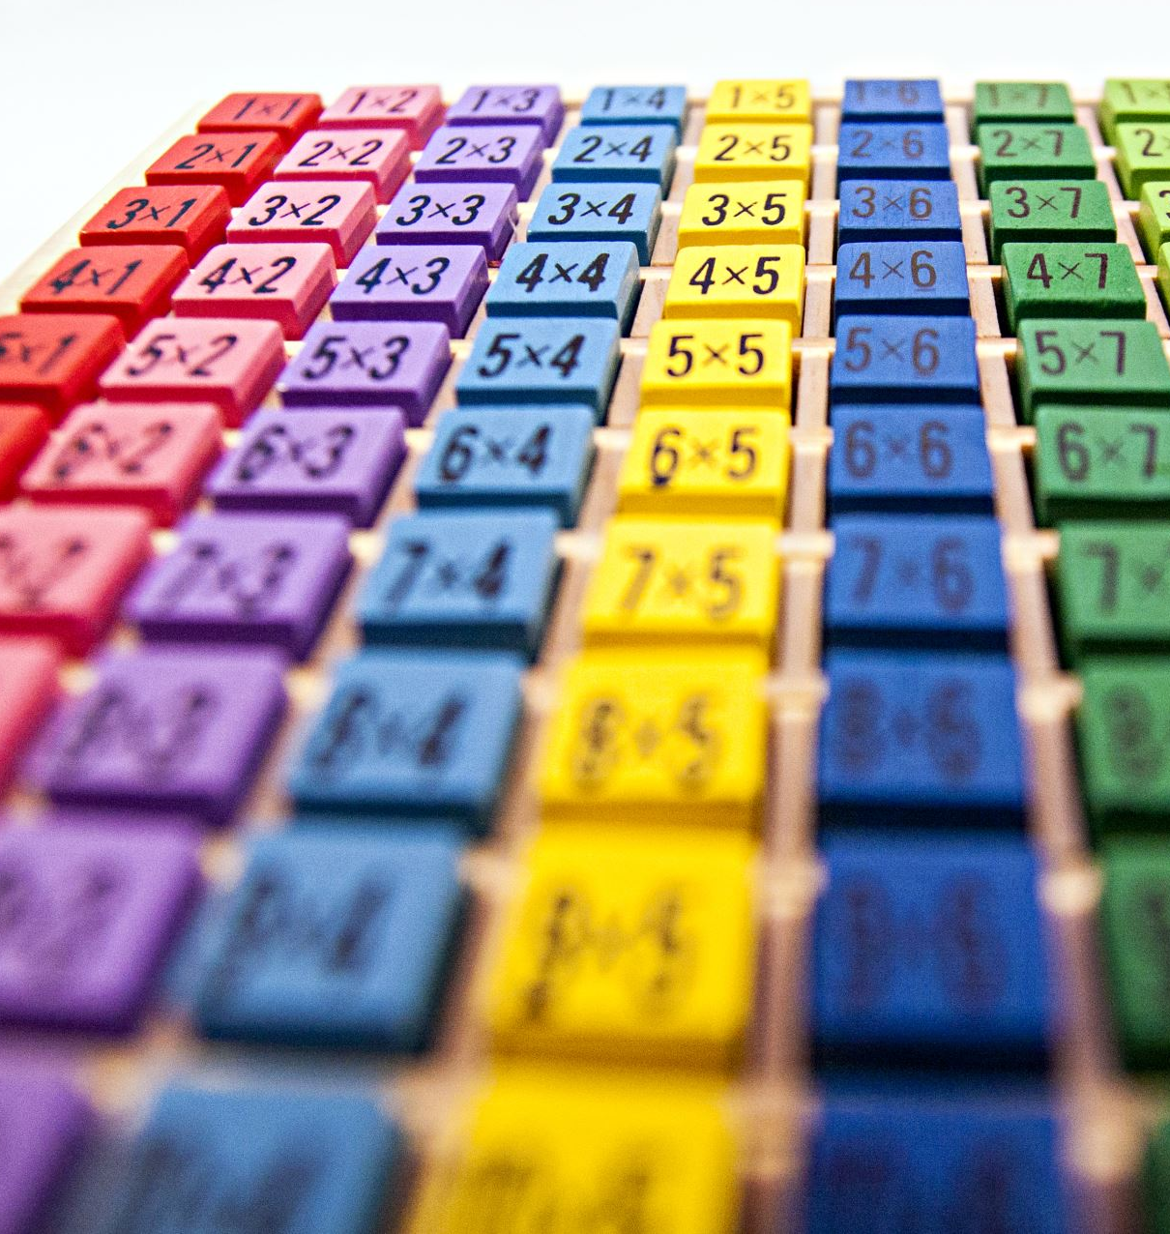
Introduction to CSP (Constraint Satisfaction Problems)
A CSP involves finding a solution that satisfies a set of constraints.
Key Components:
Variables: Elements needing values
Domains: Possible values
Constraints: Conditions that must be met
Real-life Examples:
Sudoku
Color mapping
Scheduling Problems
Puzzle-solving

Slide 3

CSP Workflow
Define variables
Assign domains
Apply constraints
Find a valid solution

Slide 4

What is Graph Coloring?
Graph coloring is a way of assigning colors to the vertices or edges of a graph such that certain conditions are met.
It is widely used in various applications such as map coloring, scheduling and frequency assignment.

Slide 5
Mathematical Representation Graph coloring is often represented as function:𝑓:𝑉→𝐶
where:
𝑉:V is the set of vertices.
𝐶:C is a set of colors.
f:f is called the coloring function

Slide 6

Condition for Valid Coloring
For a valid vertex coloring, no two adjacent vertices should have the same color:
f(v)!=f(w)for all edges (v,w)∈E
Consider a simple graph with vertices:
𝑉={𝐴,𝐵,𝐶}
𝐶={Red, Blue, Green}
Edges: (𝐴,𝐵)(B,C),(C,A)
A valid coloring function could be:
𝑓(𝐴)=Red,𝑓(𝐵)=Blue,𝑓(𝐶)=Greenf(A)=Red,f(B)=Blue,f(C)=Green

Slide 7
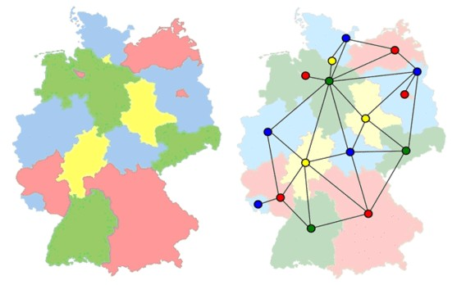
Solving Graph Coloring using CSP
Backtracking Algorithm:
1. Assign a color to a node.
2. Check constraints with adjacent nodes.
3. If valid, move to the next node; if not, backtrack.
Constraint Propagation Techniques:
- Forward Checking: Eliminates invalid color choices early.
- Arc Consistency: Ensures no conflicts.

Slide 8

How My Tool Uses CSP for Graph Coloring
Tool Features:- Uses CSP-based Backtracking algorithm.
- Allows users to input nodes and edges and colour.
- Visualizes the graph with assigned colors.
Key Functionalities:-Dynamic Graph Visualization
- Constraint Checking in Real-Time

Slide 9
Demonstration of the Tool
Live Demo or Screenshot:
- User inputs number of nodes, colors, and edges.
- The graph is displayed with correct color assignments.

Slide 10
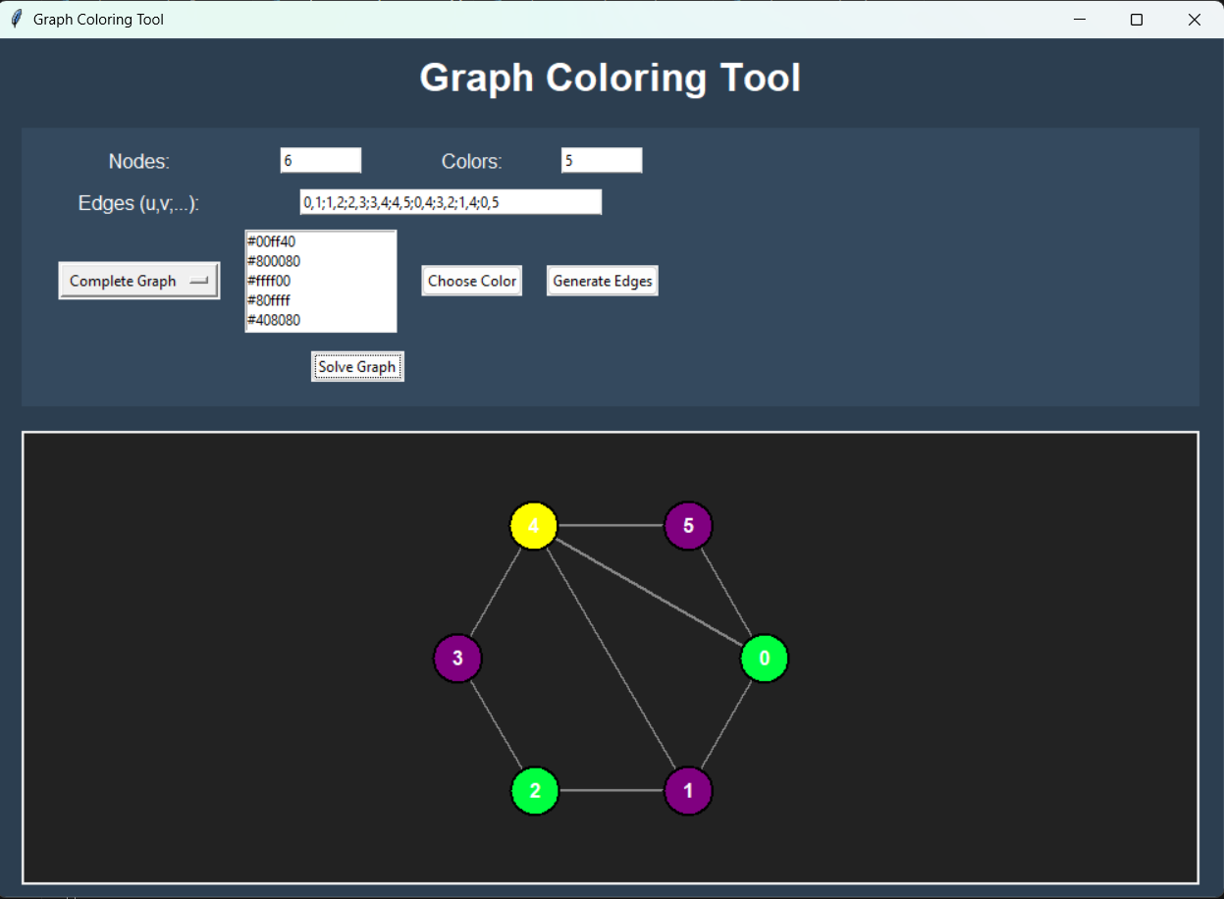
GRAPHICS USER INTERFACE:

Slide 11

Applications of Graph Coloring
1.Map Coloring Ensuring that adjacent regions have different colors.
2. Sudoku and Puzzles Sudoku can be seen as a graph coloring problem where each row, column, and block must contain unique numbers.

Slide 12

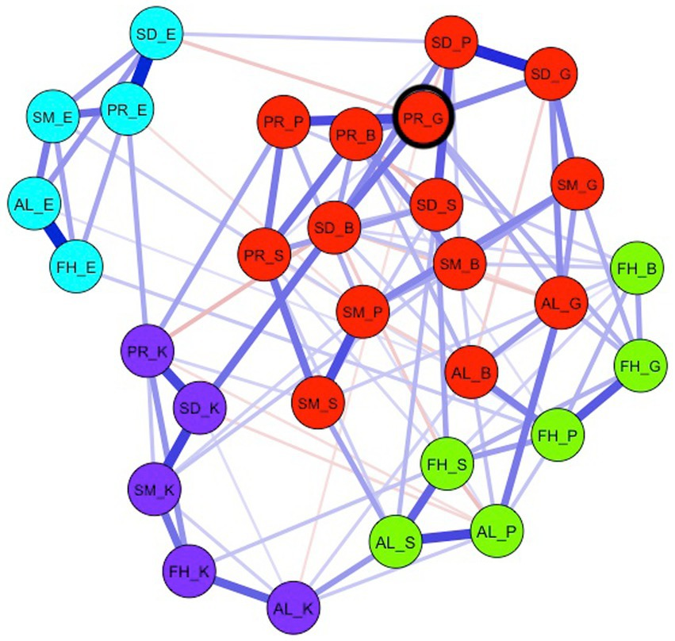
Challenge in Graph Coloring
Large graphs increase complexity.
When dealing with a large number of nodes and edges, the number of possible ways to color the graph increases exponentially.
Solution
Heuristic technique( like Forward checking)
To handle large graphs efficiently, heuristic techniques like Forward Checking help by reducing unnecessary calculations.

Slide 13

Performance and Optimization
Time Complexity: O(mⁿ)
where m = colors, n = nodes.
Optimization Techniques:
Forward Checking: Reduces Invalid assignments early.

Slide 14

Future Improvements & Enhancements
Possible Improvements:
- AI-based optimal color selection.
- Better UI/UX.
- Handling larger graphs efficiently.
Future Extensions:
- Multi-color graph coloring.
- Parallelized CSP algorithms for faster execution.

Slide 15

Thank You!
Any Questions?

